Slide 1
LAB – 02
RECURSION and structure

Slide 2

Task - 1
Write a recursive function in C++ to calculate the factorial of a non-negative integer n. The function should return 1 for n = 0 or n = 1. If a negative number is entered, display an error message.

Slide 3

Task - 2
Write a recursive function in C++ that prints numbers from n down to 1 in descending order. The function should take a single integer n as input and recursively print the numbers. If n is less than or equal to 0, the function should terminate without printing anything.

Slide 4

Task - 3
Write a recursive function in C++ to find the greatest common divisor (GCD) of two integers using the Euclidean algorithm. The GCD of two numbers is the largest number that divides both of them without leaving a remainder. The recursive function should stop when one number is a divisor of the other.

Slide 5

Task - 4
Write a C++ program that uses recursion to generate the Fibonacci series up to n terms. The Fibonacci series is a sequence of numbers where each number is the sum of the two preceding ones, starting with 0 and 1. The recursive function should return the nth Fibonacci number, and the program should print the series up to the specified number of terms.

Slide 6
Task - 5
Write a recursive function in C++ that counts the number of times a specific character appears in a given string. The function should take three parameters: the character to search for, the string (as a character array), and the current index (subscript) to examine. Use recursion to traverse through the string until the null terminator (\0) is encountered.
The function should:
Return 0 when the end of the string is reached.
Return 1 + recursive call if the current character matches the search character.
Return only the recursive call if the current character does not match the search character.

Slide 7
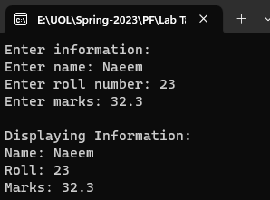
Task - 6
Write a program to store and display information using structure

Slide 8
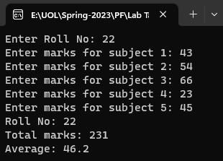
Task - 7
Write a program that declares a structure to store roll number and marks of five subjects. It defines a structure variable, inputs the values and displays roll no, marks and average marks.

Slide 9
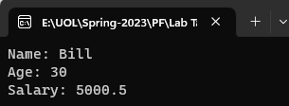
Task - 8
Write a program that demonstrates the passing of entire structure as parameters to the called function.

